Slide 1

PhoneGap Cordova Training Day 1

Slide 2

Mobile Development using Cordova
Table of Contents
Introduction to Apache Cordova
Prerequisites
Technology Stack -HTML5,CSS, JAVASCRIPT
Other Technology Stack on Cordova

Slide 3
Introduction to Apache Cordova

Slide 4
Introduction to Apache Cordova
Why PhoneGap?
Cross platform applications with HTML/JS will be faster and easier
What is Apache Cordova ?
“Apache Cordova is a set of device APIs that allow a mobile app developer to access native device function such as the camera or accelerometer from JavaScript.”
– http://cordova.apache.org/
– A platform-specific engine that exposes access to native device functionality through a series of JavaScript APIs.
– Phonegap is actually an open source distribution of Cordova.
What is PhoneGap ?
PhoneGap is an open-source mobile development framework produced by Nitobi, purchased by Adobe Systems
PhoneGap is an open source solution for building cross-platform mobile apps with standards-based Web technologies like HTML, JavaScript, and CSS.

Slide 5
Introduction to Apache Cordova
Hybrid Application Development= NATIVE + Mobile WEB Technologies
Advantages of a hybrid approach:
Faster time-to-market when compared to pure native app development time cycles(App store distribution)
Lower total cost of ownership as the cross-platform adaptability is easier[Native look-and-feel -without the native cost ]
Reasonably good UX experience with modern Java script toolkits (gestures, swipes, taps and transitions)
Easy maintainability, upgrades and deployments
Access to native device features
Inexpensive cross-platform development
Disadvantages of a hybrid approach:
Slightly lower performance with the rendering of web pages, data access across multiple layers, etc.
Limited UX experience, compared to native UI
Security concerns

Slide 6
Introduction to Apache Cordova
 | Hybrid App
Skills/tools needed for cross-platform app development | HTML CSS Javascript Web programming language (i.e., Java) Mobile development framework
Apps needed to reach all major smartphone platforms | 1
Installed on device? | Yes
Distribution | App Store/Market
Device integration | Full integration: (camera, microphone, GPS, , accelerometer, file upload, contact list)
Best used for | Cross-platform apps that need full device access. Business apps that need app store distribution

Slide 7
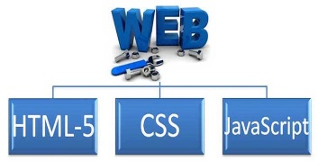

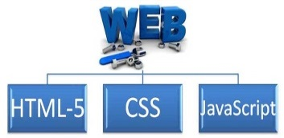
What is PhoneGap?
1
2
Your Code
Your Code
Your Code
Native Web View
3
4
Your Code
Native Web View
Your Code
Native Web View
Native APIs
Native APIs
Native App - .apk, .xap, etc.

Slide 8
What is PhoneGap
PhoneGap uses the native browser on the device to render the HTML/CSS/JS
PhoneGap uses the native project format for each platform
Open, emulate, and test from within the native development environment
Since PhoneGap using the native projects, it’s fully extendable
PhoneGap provides a JavaScript library that reaches out into the native APIs(means anything the device is doable)
PhoneGap is completely open source and has been submitted to the Apache Foundation
PhoneGap provides the number of device API’s
PhoneGap for Windows Phone 8:
Starting from Apache Cordova 2.3.0, released on 7th of January 2013 has a full support for Windows Phone 8
Windows 8 apps can be designed and coded using HTML, CSS and JavaScript just like PhoneGap apps can
Because Microsoft has integrated a new security model in Windows 8, jQuery has to be modified slightly in order to be usable for app development
- Accelerometer - Camera - Capture - Compass
- Connection - Contacts - Device - Events -Storage
- File - Geolocation - Media - Network -Notification

Slide 9



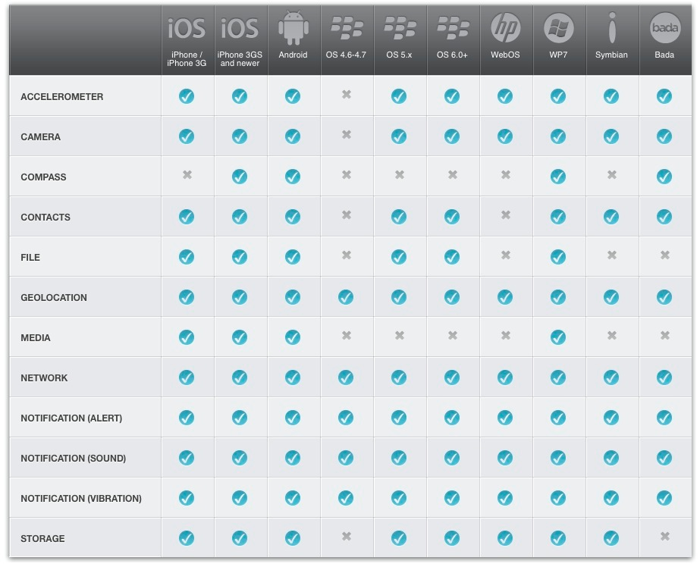
Getting Started with PhoneGap
There are multiple ways to “start” with PhoneGap
The project includes command line tools, IDE plugins, and Dreamweaver ships with PhoneGap support
can use ANY framework to design a mobile app Ex: Jquery Mobile

Slide 10
Debugging PhoneGap
Phonegap coding is done using just HTML/JS, so we can use your browser. Could take advantage of Chrome Developer tools/Firebug to test your app’s UI
How to Debug Device API’s? Because we’re in the web view, there is no way to do line-by-line debugging
we have tool called Weinre, which lets us debug and manipulate the DOM from our PCs
Easy way to debug: http://debug.phonegap.com/

Slide 11
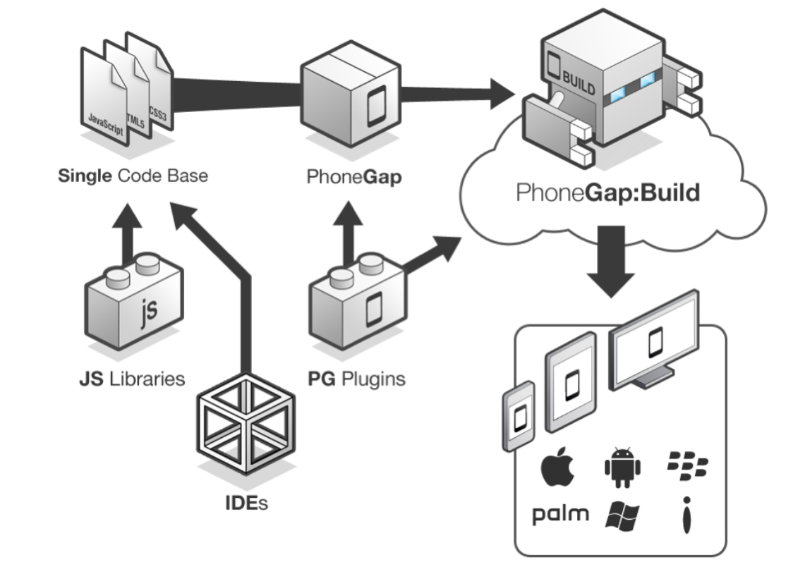
Extending PhoneGap
For added functionality PhoneGap provides a plug-in mechanism
Includes OS-specific code/libraries and the JS to use it in PhoneGap Some of the helpful ones: PayPal, Facebook, Push Notification
Considerations on PhoneGap
Always test features first (if !supported)
For UI-specifics, you can use the device
class to get device info
Build PhoneGap Apps in the Cloud
The problem on building a cross-platform app is, dealing with a lot of native projects. So the solution can be as below(build.phonegap.com)
Build includes git support so you can use git and host projects on PhoneGap or build a project from Github (https://github.com/mmateev/TwitterCordovaApp/ )

Slide 12
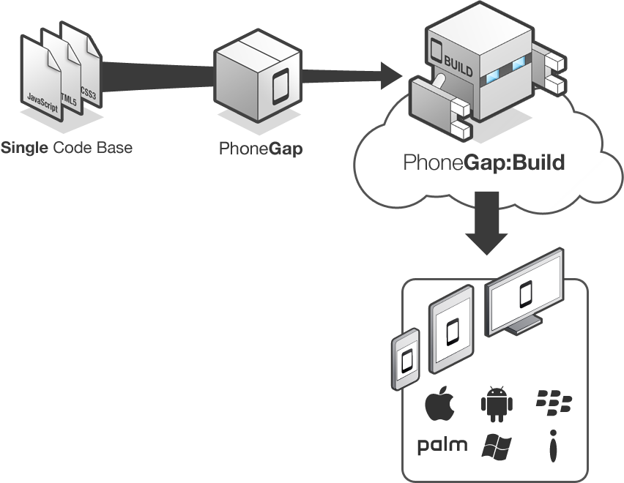
How does PhoneGap Work?
Include web code in a native app project:
- assets/www/js/, css/, images/, etc.
Native code loads a URL to the web code through the device’s internal browser:
- Extend a CordovaWebViewClient
- super.loadUrl( “file:///android_asset/www/login.html” );
Apache Cordova exposes native device APIs through JavaScript:
- navigator.device.capture.captureImage( captureSuccess(), captureError(), [options] );

Slide 13
Prerequisites

Slide 14
Prerequisites
Integrated Development Environment
Java IDE like Eclipse or IntelliJ for Android
Xcode for iOS
Mobile Platform SDK
Node JS
Apache Cordova
Mobile Devices
Recommended for deployment/testing
Emulators are alternative but not a true test
Technology Stack to know
HTML5/CSS/Javascript
cordova.js to be included in each html file to enable Cordova libraries
www.phonegap.com

Slide 15
Technology Stack –HTML5,CSS, JAVASCRIPT

Slide 16
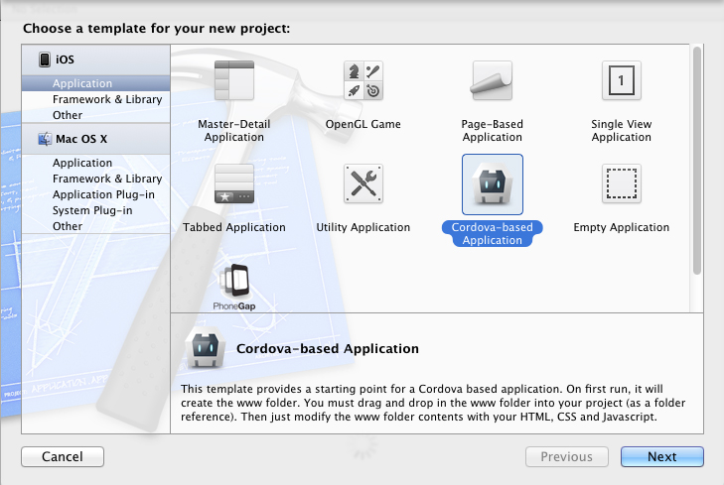
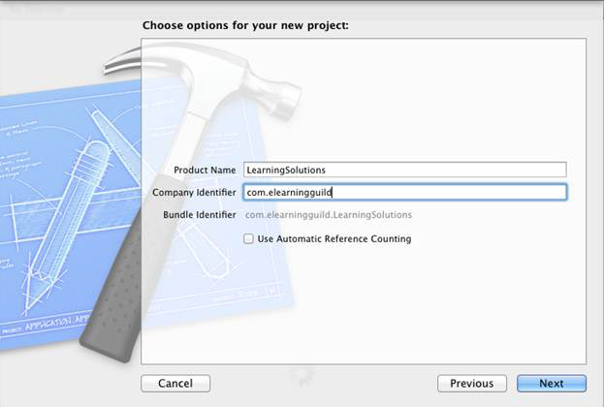
Technology Stack -HTML5,CSS, JAVASCRIPT
Create PhoneGap application on XCode
PhoneGap builds a native application to display HTML5 application in a browser control
PhoneGap builds bridges between the hardware and cordova application (hardware in JavaScript )
Provide the identifier appropriately like com.testapp
Make sure the check is removed from the automatic reference counting option. Keeping this option checked will cause your PhoneGap applications to break
Click on Next to choose a location to save your project files.
The next step is to run the PhoneGap application. Press the Run button in the upper left hand corner of the Xcode interface.
In few minutes, Emulator will appear & below error massage could be seen “ERROR: Start Page at ‘www/index.html’ was not found”
In project folder, drag www folder into main project

Slide 17
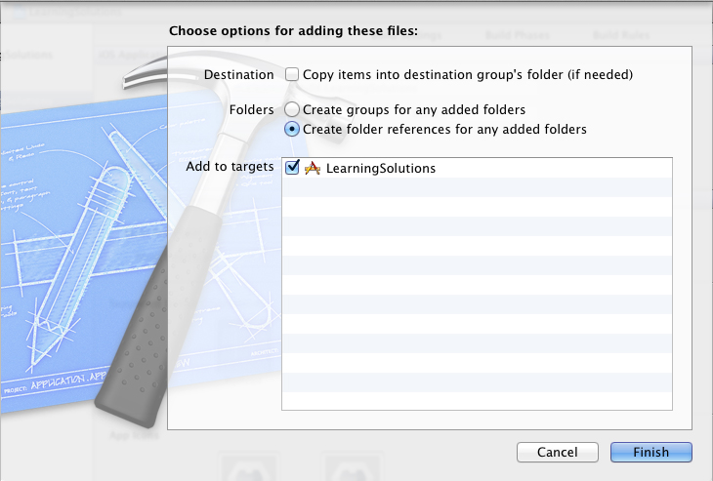
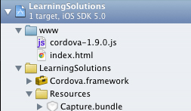
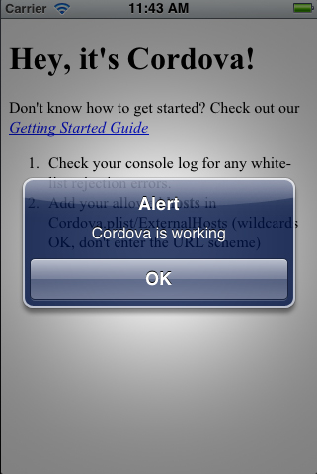
Technology Stack -HTML5,CSS, JAVASCRIPT
9. Click on Finish to create the cordova project successfully
Once project is created, the folder structure should look like below diagram
Run the project, then the default greeting screen should appear on the emulator & alert should also be shown
Index.html in www folder is the starting point of the application
All html content should appear under .html page
Js folder should hold the javascript/jQuery Mobile
Images folder holds all the images that is require for application
Config file , to set the configuration details

Slide 18
HTML5
Motivation and objectives
Main reasons
One key argument: classical HTML ...
Historically intended for documents.
Not adequate support for web applications.
Other issues:
Forms handling insufficient
Elements (“tags”) not matching prevalent needs
look-and-feel and behavior is decided by browsers etc
Stakeholder challenges
End users:
− Web content look-and-feel and behavior depends on browser.
− Variation in look-and-feel and behavior depends on content authoring styles
Web content creators:
− Browser independent authoring difficult
− Misuse of markup when needs do not match markup vocabulary
Browser vendors:
− Not completely well defined: script execution, ...
− Handling of ill-formed content

Slide 19
HTML5
Objectives
Provide good support for modern documents and web applications
− Web 2.0; social sites; online shops; ...
Support legacy web content
Optimize backward compatibility
− HTML4, XHTML 1
Cover common browser functionality
Make web content authoring more uniform
Clarify processing model ... conforming and non-conforming contents
About HTML5
HTML 5 is a content model, not a syntax
Emphasizes what web contents consists of, not how it is represented.
Definition of Document Object Model
Common base for HTML and XHTML

Slide 20
HTML5
HTML 5 ==> HTML and XHTML
What is new?
Structure of textual documents - section, article, header, footer, ...
Multimedia - audio, video, embed, ...
Graphics - canvas, figure, ...
Forms - input, ...
Editing - drag-and-drop, copy-and-paste, undo, ...
What is removed?
Text - big, font, tt, ...
Frames - frame, frameset, noframes, ...
Misc - applet, acronym, ...
Conclusions : HTML 5 is the robust replacement of HTML4, XHTML 1and DOM2/HTML
Target: re-engineer HTML to match current and forthcoming needs
- Knowledge base: multiple years of web content creation
Target: preserve value of present investment in web contents
- Backward compatibility
Target: predictable browser behavior on ill-formed contents
- Harmonizing handling of contents with errors

Slide 21
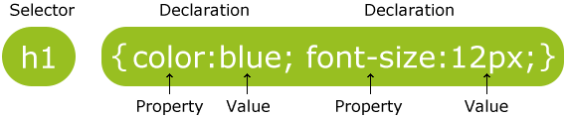
CSS
CSS stands for Cascading Style Sheets
Styles define how to display HTML elements
Styles were added to HTML 4.0 to solve a problem
External Style Sheets can save a lot of work
External Style Sheets are stored in CSS files
CSS Syntax:
A CSS rule set consists of a selector and a declaration block:
The selector points to the HTML element you want to style.
The declaration block contains one or more declarations separated by semicolons.
Each declaration includes a property name and a value, separated by a colon.

Slide 22
Difference Between CSS and CSS3
CSS3 has been split into "modules". It contains the "old CSS specification" (which has been split into smaller pieces). In addition, new modules are added.
Some of the most important CSS3 modules are:
Selectors
Box Model
Backgrounds and Borders
Image Values and Replaced Content
Text Effects
2D/3D Transformations
Animations
Multiple Column Layout
User Interface

Slide 23
JAVASCRIPT
Javascript Basics
JavaScript is:
JavaScript is a lightweight, interpreted programming language
Designed for creating network-centric applications
Complementary to and integrated with Java
Complementary to and integrated with HTML
Open and cross-platform
JavaScript Syntax:
<script ...> JavaScript code </script>
Example
<script language="javascript" type="text/javascript"> JavaScript code </script>
First script
<html>
<body>
<script language="javascript" type="text/javascript">
<!--
document.write("Hello World!")
//-->
</script>
</body>
</html>
Refer : http://www.tutorialspoint.com/javascript/javascript_objects.htm

Slide 24
JAVASCRIPT
Javascript Objects
JavaScript is an Object Oriented Programming (OOP) language. A programming language can be called object-oriented if it provides four basic capabilities to developers:
Encapsulation . the capability to store related information, whether data or methods, together in an object
Aggregation . the capability to store one object inside of another object
Inheritance . the capability of a class to rely upon another class (or number of classes) for some of its properties and methods
Polymorphism . the capability to write one function or method that works in a variety of different ways
<html><head><title>User-defined objects</title>
<script type="text/javascript">
var book = new Object(); // Create the object
book.subject = "Perl"; // Assign properties to the object
book.author = "Mohtashim";
</script>
</head>
<body>
<script type="text/javascript">
document.write("Book name is : " + book.subject + "<br>");
document.write("Book author is : " + book.author + "<br>");
</script>
</body></html>

Slide 25
JAVASCRIPT
Advantages:
Javascript is executed on the client side
Javascript is a relatively easy language
Javascript is relatively fast to the end user
Speed, Simplicity, Versatility
Disadvantages:
Security
Reliance on End User

Slide 26
Other Technology Stack on Cordova
Useful Plug- ins
Underscore.js – “a utility-belt library for JavaScript that provides a lot of the functional programming support”.
Example:
var tmpl = "<% for(var i=0; i < 10; i++){%>" +
"<% console.log('Hello from template'); %>" +
"<% } %>";
_.template(tmpl, {});
Here,
<%= item.name %> – Outputs value
<% for(){ %> <% } %> – Executes JavaScript.
Refer:
//underscorejs.org/ //github.com/jashkenas/underscore/blob/master/underscore.js

Slide 27
Other Technology Stack on Cordova
SimpleDialog2 – Provides an easy interface to build mobile dialogs pop-ups.
Example:
<ul data-role="listview">
<li><a href="#">baz</a></li>
</ul>
$(function() {
// When user clicks on a list item, produce a dialogue/alert box.
$('[data-role="listview"] a').click(function(event) {
event.preventDefault();
$('<div>').simpledialog2({
mode: 'blank',
headerText: "Popup title"});
});
});
Refer:
//github.com/jtsage/jquery-mobile-simpledialog/blob/master/js/jquery.mobile.simpledialog.js

Slide 28
Other Technology Stack on Cordova
Backbone.js – Gives structure to web applications by providing models with key-value binding and custom events, collections with a rich API of enumerable functions, views with declarative event handling, and connects it all to your existing API over a RESTFUL JSON interface.
Example:
var Sidebar = Backbone.Model.extend({
promptColor: function() {
var cssColor = prompt("Please enter a CSS color:");
this.set({color: cssColor});
}
});
Refer:
//backbonejs.org/
//github.com/jashkenas/backbone/blob/master/backbone.js

Slide 29
Other Technology Stack on Cordova
Angular.js – JavaScript framework and extends HTML attributes with Directives, and binds data to HTML with Expressions. It extends HTML with ng-directives.
The ng-app directive defines an AngularJS application.
The ng-model directive binds the value of HTML controls (input, select, textarea) to application data.
The ng-bind directive binds application data to the HTML view.
Example:
<body>
<div ng-app="" ng-init="firstName='John'">
<p>The name is <span ng-bind="firstName"></span></p>
</div>
</body>
Refer:
//angularjs.org/
//ajax.googleapis.com/ajax/libs/angularjs/1.2.0/angular.min.js
Attached Angular JS PPT with Sample Application

Slide 30
Other Technology Stack on Cordova
Require.js-JavaScript file and module loader. It is optimized for in-browser use, but it can be used in other JavaScript environments, like Rhino and Node. Using a modular script loader like RequireJS will improve the speed and quality of your code.
Example:
define(function(require){
var alerter = require("alerter");
alerter("hello for app")
})
Refer:
//requirejs.org/
//github.com/jrburke/requirejs/blob/master/require.js
Knockout.js – Simplifies dynamic JavaScript UIs by incorporating a Model-View-View-Model pattern for dynamic data binding.
function AppViewModel() { this.firstName = "Bert"; this.lastName = "Bertington"; } ko.applyBindings(new AppViewModel()); // Activates knockout.js
Refer:
//knockoutjs.com/
//cloud.github.com/downloads/knockout/knockout/knockout-2.2.0.js

Slide 31
Apache cordova - Pros & Cons
Highlights/Benefits Of Cordova
Develop once
Multiplatform support
Port web apps to mobile
Access native funtionality via API’s
5 MB HTML 5 local storage limit
Chrome Desktop testing requires local file access permission (Disable web security for chrome from command prompt)
Inconsistent mobile browser anomalies
Inconsistent performance among devices
Some native application code required - extend a CordovaWebViewClient and load the URL to the website.
Web code is not compiled and is accessible
Possible Downside
Lost/inaccessible native features
Less rich UI style

Slide 32
Hybrid vs Native Application
 | Hybrid Application (Cordova) | Native Application
Can be uploaded to App Store | Yes | Yes
Technology | HTML + CSS + JavaScript | Native platform Programming Language
Cross-mobiles support | Yes | No
Development Speed | Faster | Slower
Uses Device Native Features | Yes | Yes

Slide 33
Daily Assignment – Day 1
Setup PhoneGap Environment in Mac/Windows
Prepare sample application to display “Welcome To Cordova” in alert, either on ios/Android
Word Document Attached – Tips to setup cordova on Windows + Mac (Double click to open the doc)

